Slide 1

Makino Car Marketplace and Diary Companion for the Albanian Market
Mateo Sheme

Slide 2

Let’s say you are looking for a new car to buy in Albania, where do you start?

Slide 3
6. Just giving up...
1. Call that dealership friend
2. Look in the overwhealming merrjep.al
5. Look for other unknown marketplaces
3. Sketchy Facebook Marketplace
4. Glorified Instagram
Sellers

Slide 4
01
Problem : Missing of a unified platform

Slide 5

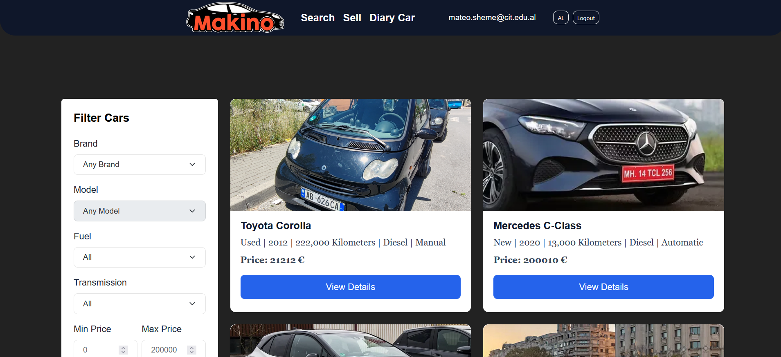
Ease of searching and multiple selections of cars

Slide 6
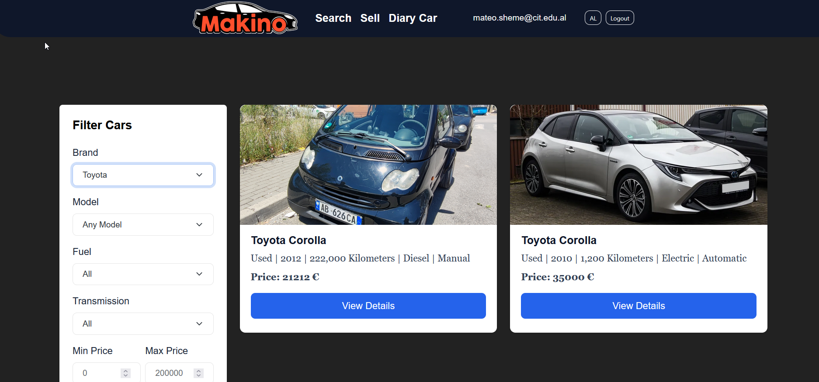
Ability of filtering as needed

Slide 7
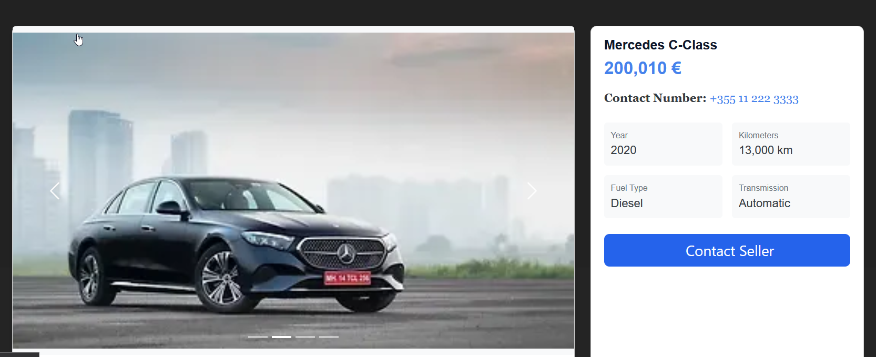
Details, price and contact number, no more extra information needed

Slide 8
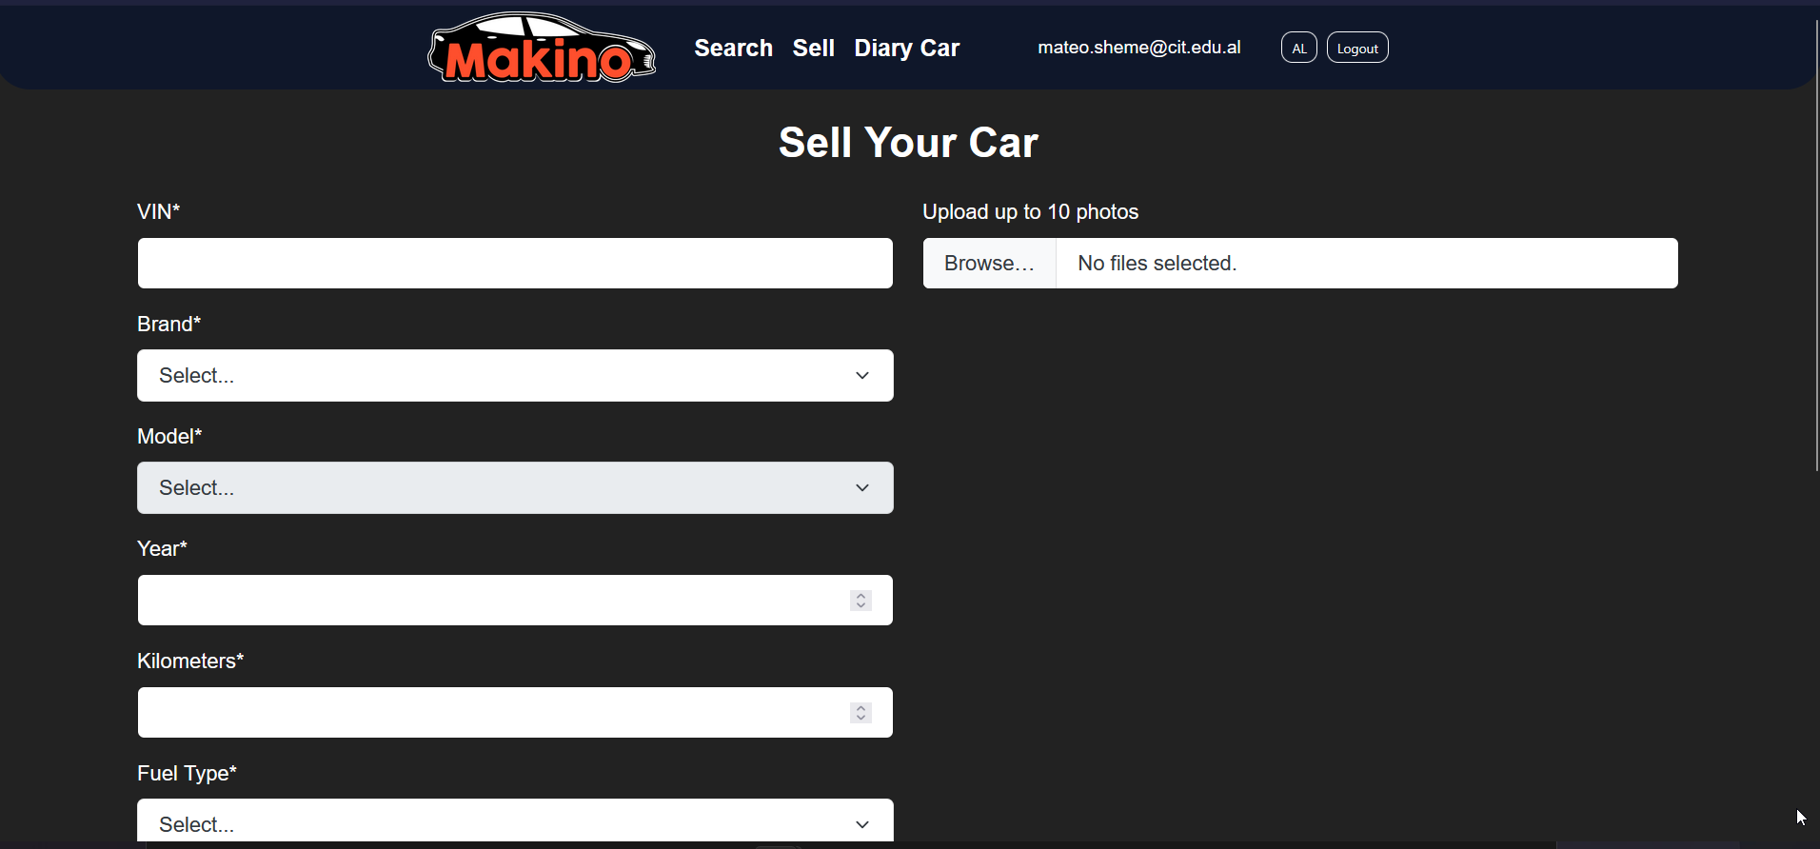
Anyone can post their car details

Slide 9
How can we improve it more?
Tell me your last mondande task you had to do to your car...

Slide 10

I’ll go first oil check BUT... when is my next oil check though?

Slide 11
02
Problem : Dedicated diary for the car

Slide 12
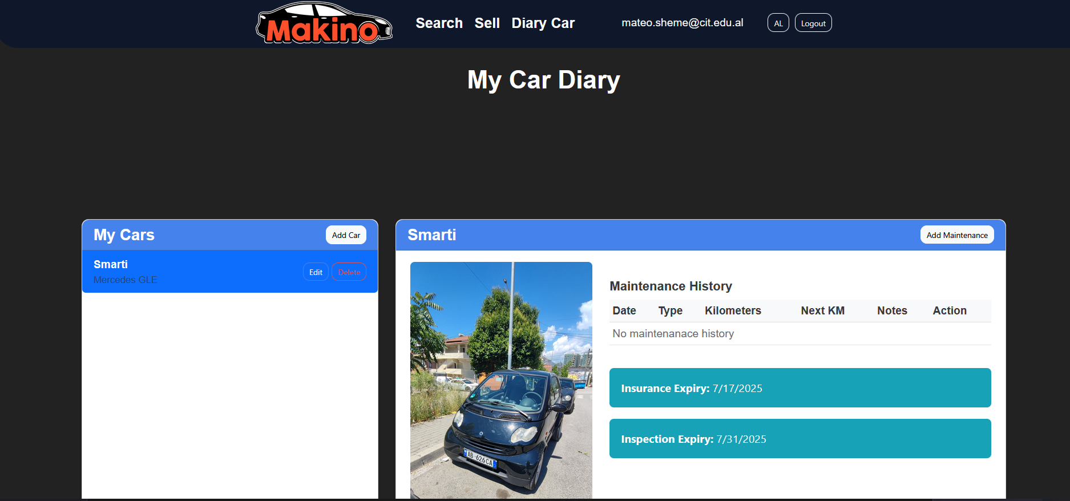
Well here we have it someone to finally keep track of our car

Slide 13
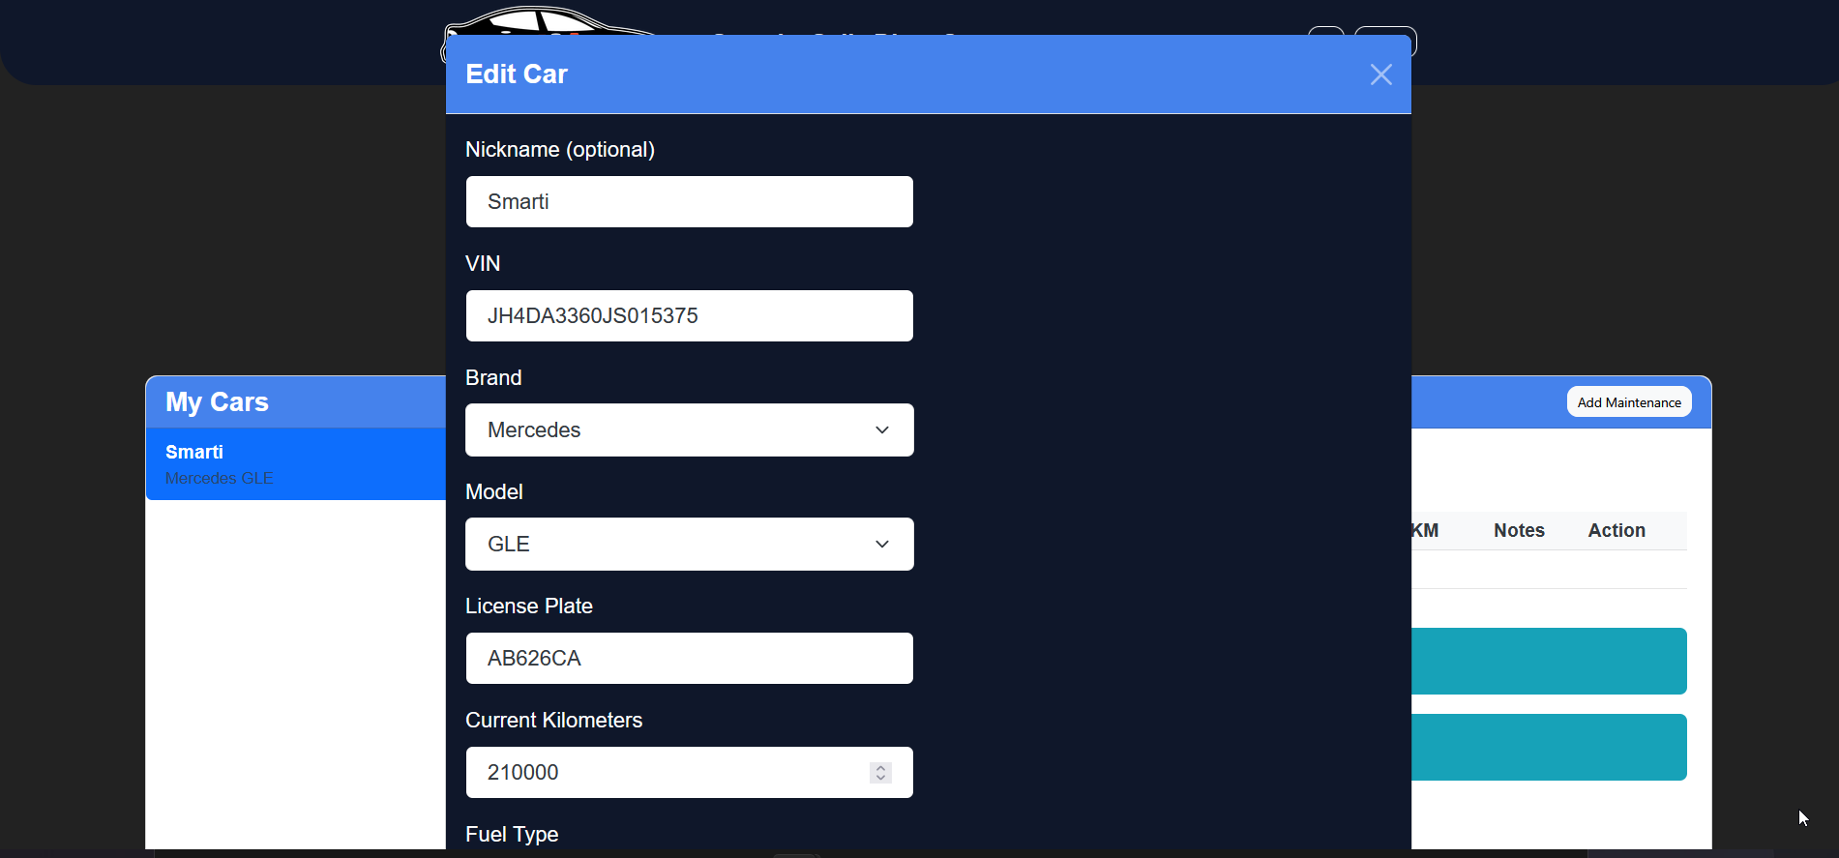
All the details of the car, and possibility to have many cars

Slide 14
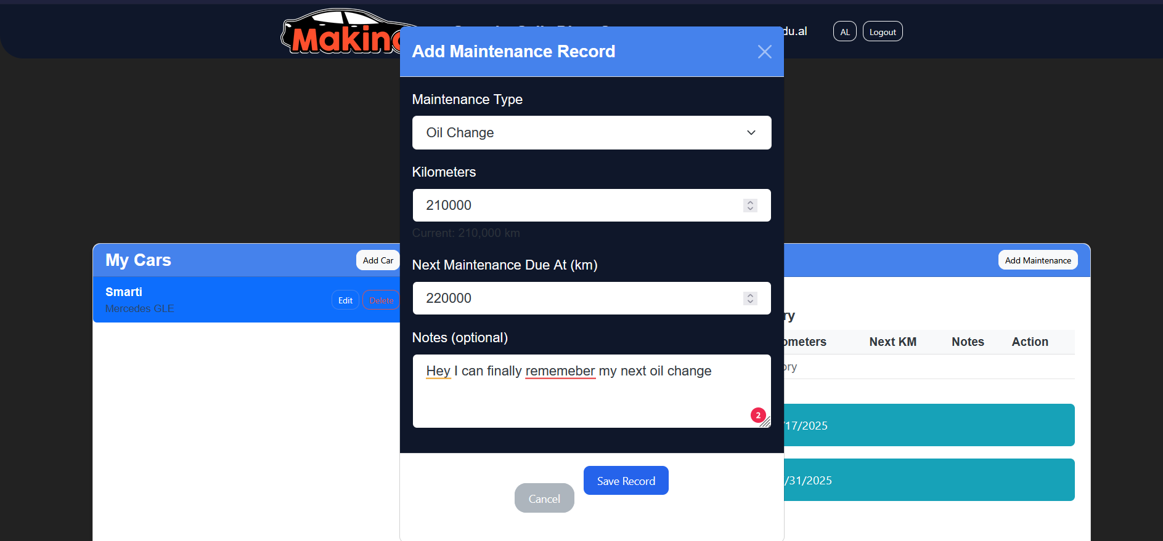
As well as possibility to save maintenance record

Slide 15
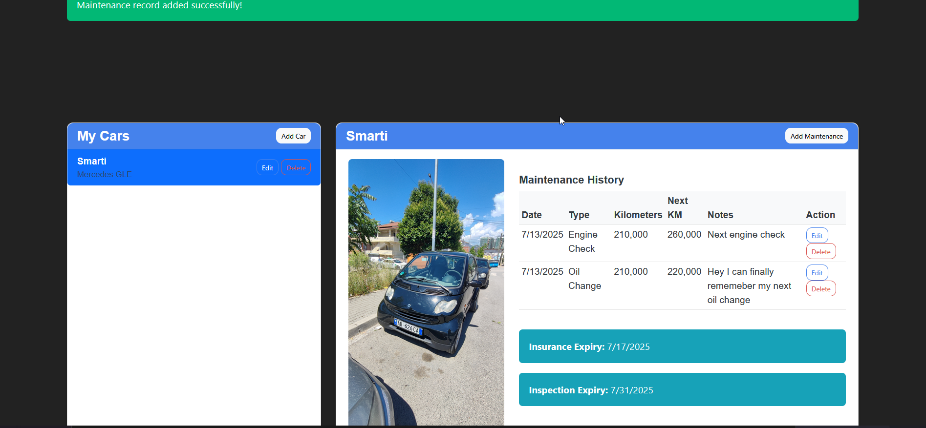
All neatly tied and easy to edit if needed

Slide 16
More neat features

Slide 17
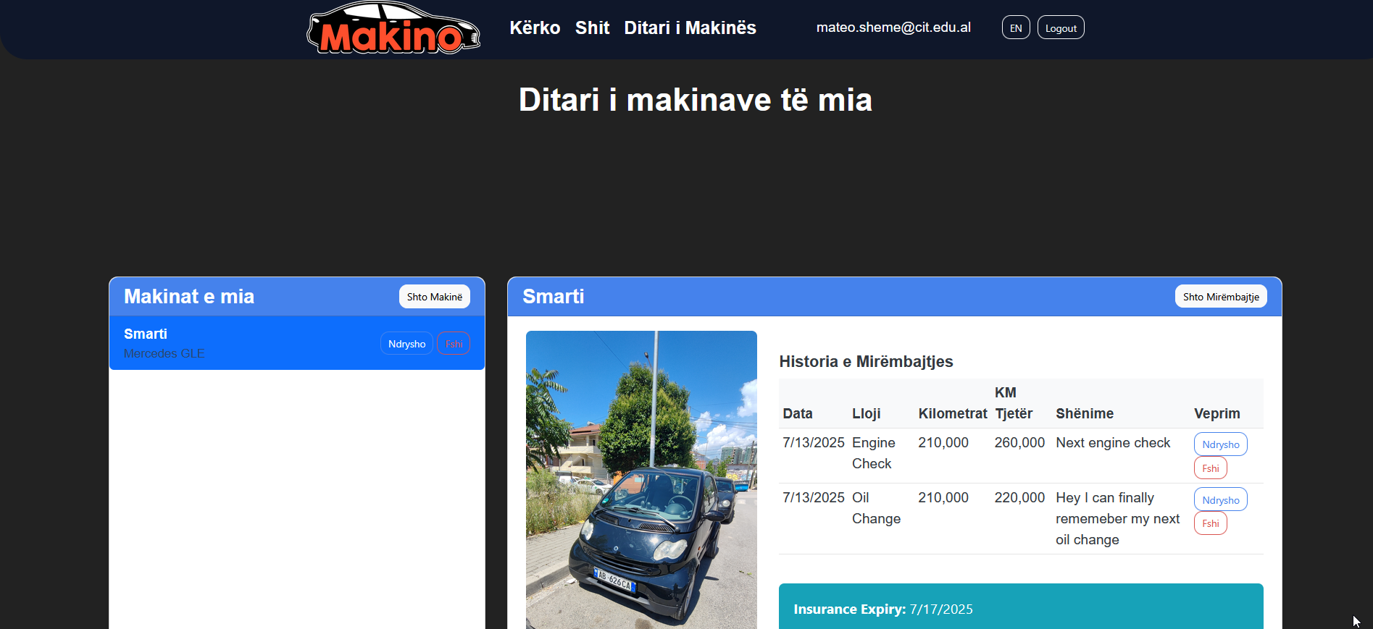


Avaliable in both Albanian and English!

Slide 18
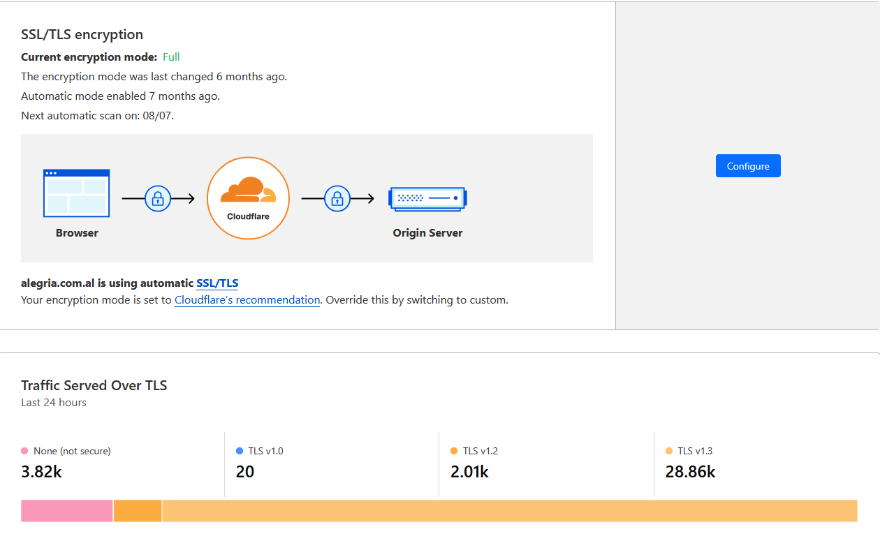
Securing passwords by hashing them using PBKDF2 with HMAC-SHA256
Under the protection of outside threats from CloudFlare
Notes:
PBKDF2 = Password-Based Key Derivation Function 2
HMAC = Hash-based Message Authentication Code
SHA256 = Secure Hash Algorithm 256-bit

Slide 19
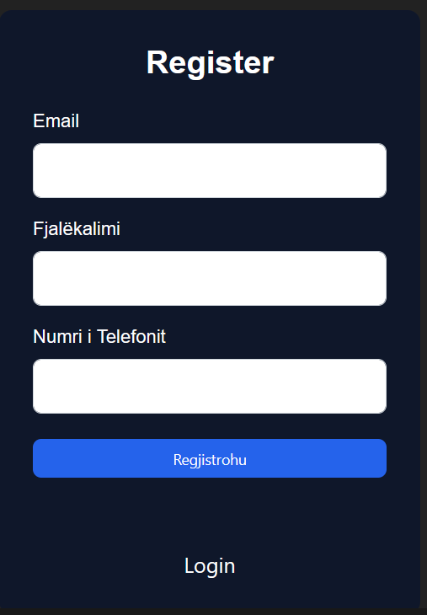
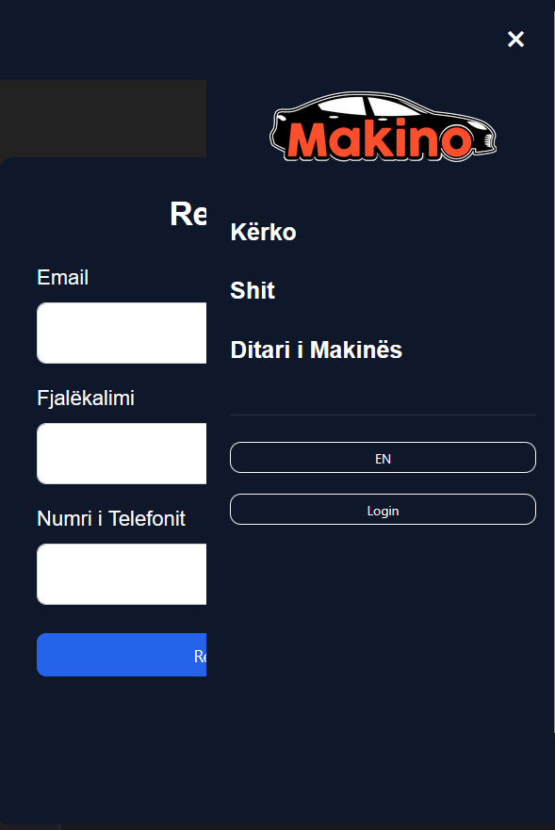
Mobile responsive

Slide 20
Technical Side

Slide 21





Tech Stack
Frontend
Backend
Database
Deployment

Slide 22
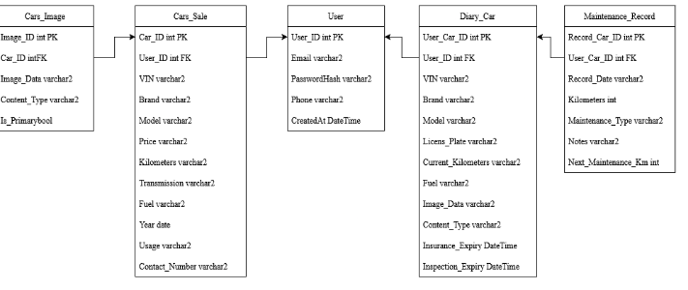
Database Schematic

Slide 23
Thanks!
Mateo Sheme

